Slide 1

Movie Recommendation System
Group-8
Sambuj, Dhara
Josthana, Runkana
Surya Vamshi, Sriperambudooru

Slide 2
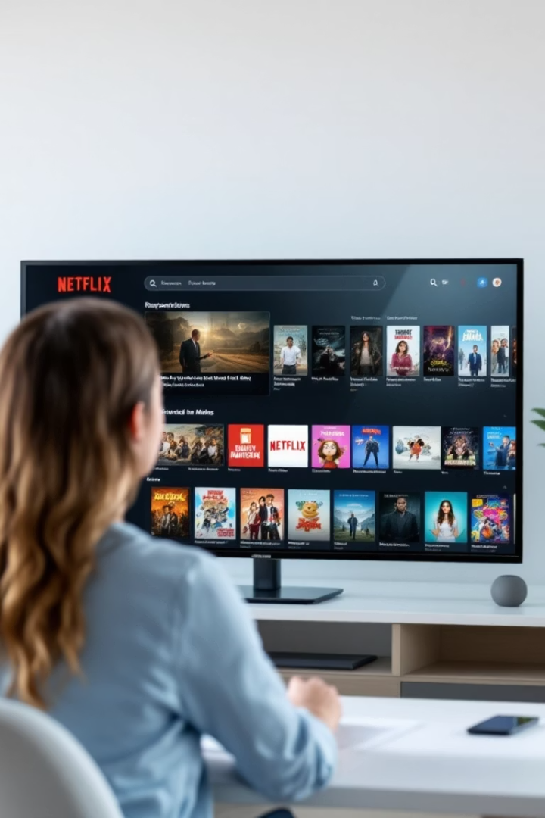

Problem Statement
Project Goal
This project aims to develop a content-based recommendation system and provide relevant movie suggestions based on movie features.

Slide 3








Recap and Today's Agenda
TF-IDF with Cosine Similarity Methodology
Milestone-1
Project Proposal & Data Preparation
Input
User selects 1 movie or TV show
Milestone-2
Feature Extraction
Analysis & Model Development
Extract text features from movie descriptions
Milestone-3
TF-IDF Vectorization
Draft Results & Model Evaluation
Convert text to numerical vectors
1. Model Evaluation
2. Feature & Error Analysis
Cosine Similarity
3. Insights & Business applications
Calculate similarity between movies
4. Model Limitations and Bias
Recommendation
Generate list of 10 recommended movies/TV shows

Slide 4

Model Evaluation
Evaluation Process
Evaluation Scope
Key Metrics
Model evaluation is the process of measuring a model's performance using appropriate metrics to assess its accuracy, effectiveness, and reliability. In this project, It helps determine how effectively the system surfaces relevant, varied, and lesser-known content for a given title.
With no user feedback or ground truth, traditional accuracy metrics couldn’t be applied. The dataset contains 8,800+ titles, and for feasibility, the model was evaluated on 103 diverse input titles, using alternative metrics to assess performance.
Top-N Relevance
Intra-List Similarity
Novelty
Catalog Coverage

Slide 5


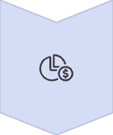

Top-N Relevance (Genre Overlap)
Goal
Evaluate how many recommendations share at least one genre with the input title.
Method
For each input title, check its genres and compare with recommended titles. Calculate genre match ratio: (genre matches) / (total recommendations).
Result
On average, 21.4% of Top-10 recommendations share a genre with the input title.
Findings
For "Chappie" (Sci-Fi/Action), 80% of the top-5 recommendations shared the genre, but "AlphaGo" (a documentary about AI) was recommended due to the thematic overlap due to the word AI in its description pulling down the genre overlap average.

Slide 6




Intra-List Similarity (Diversity)
Goal
Evaluate diversity in recommendations; low ILS = high diversity.
Method
Compute average pairwise cosine similarity between the 10 recommended items.
Result
Achieved an average ILS of 0.0929, indicating high diversity across 103 test cases.
Findings
For "Chappie" (Sci-Fi/Action), recommendations were diverse: from "District 9" (sci-fi) to "AlphaGo" (AI documentary), reflecting different themes (ILS ≈ 0.10).
Low ILS can reflect irrelevant recommendations, e.g., "Lincoln" (Historical Drama) suggested with "Jaws" (Horror/Thriller) due to a shared director.
High diversity, in general, is a positive sign, providing a broader range of content, improving content discovery .

Slide 7




Novelty (Long-Tail Recommendations)
Goal
Estimate how often the system recommends rare titles (appearing only once across all 103 lists).
Method
Novelty =Number of unique titles recommended once/Total unique recommended titles.
Result
The model's novelty score is 88.96%, meaning 89% of titles are unique in a single recommendation list which are not repeated.
Findings
High novelty indicates effective content discovery
Example: "Zubaan" (Indian musical drama) produced unique recommendations such as Kajraare (Indian thriller story of a singer and a music documentary called Once in a Lifetime Sessions with Moby
Novelty surfaces rare content but it might miss universally popular titles
Example: The system recommends titles like Naruto the Movie repeatedly across similar genres or franchises (e.g., other Naruto-related movies), but avoids suggesting unrelated, widely popular content like Stranger Things or Breaking Bad.

Slide 8




Catalog Coverage
Goal
Measure how much of the full Netflix catalog is utilized in recommendations.
Method
Catalog Coverage=Number of unique recommended titles/Total catalog size
Result
The model achieved a catalog coverage of 9.98%, meaning about 10% of the catalog was recommended at least once.
Findings
Despite generating only 10 recommendations per input, our model covers nearly 10% of Netflix's ~8,000-title library.
Impressive for just 103 test cases demonstrating the system’s ability to go deep into the catalog instead of recycling top hits.
This avoids content becoming "invisible" — ensuring its exposure to users.

Slide 9




Results Comparison
Key Metrics
21.4%
Understanding Our Metrics
Genre Relevance
Top-N Relevance
% of genre-matching recommendations
Ideal: Higher is better
0.093
ILS (Diversity)
Diversity
Similarity between recommendations
I
Ideal: Lower is better
89%
Novelty
Rare titles in recommendations
Novelty
Ideal: Higher is better
Catalog Coverage
10%
Portion of Netflix catalog used
Ideal: Higher is better
Catalog Coverage

Slide 10




Feature Analysis
Model Approach
Genre
The model uses a "bag of words" approach, where features like genre, plot description, cast, crew, etc., influence recommendations based on overlapping tokens.
Strongly influences recommendations in some cases like 80% in chappie but not always sufficient on its own (e.g., Jaws (Thriller) vs. Lincoln (Historical Drama)) as strong token matches can override genre differences.
Plot Description
Cast/Director
Keywords like "artificial intelligence" (e.g., Chappie (Sci-Fi/Action) and AlphaGo (Documentary)) link content thematically, but generic terms (e.g., "school") can cause mismatches (e.g., Blood & Water (Teen Drama) vs. Horrid Henry (Children's Cartoon)).
Shared cast/directors (e.g., Squid Game (Thriller) and Prison Playbook (Drama)) work well mimicking users who follow favorite actors but director names (e.g., Steven Spielberg linking Jaws and Lincoln) can cause irrelevant recommendations, as you wouldn't want to switch from a horror/thriller to a historical drama.

Slide 11

Error Analysis
Common Issues Identified:
Root Causes:
Genre mismatch due to shared director(Spielberg) Jaws → Lincoln
TF-IDF approach can't grasp semantics or context — it treats all matched words equally regardless of tone, genre, or audience.
Teen drama (Blood & Water )→ Children's cartoon (Horrid Henry) matched only on the word “school” — not on target audience or mood.
Fixes Proposed:
Weight important fields like genre more heavily.
Final Destination 2 → Barbie matched on trivial keyword like “adventure” — not meaningful similarity.
Apply stricter genre/format/audience filters.
Use a higher similarity threshold to avoid low-quality matches.

Slide 12
Improvements Implemented
THRESHOLD FILTERING
1
Prevents low-similarity titles from sneaking into Top-10 results, improving overall list quality.
2
FORMAT & AUDIENCE FILTERING
Recommends movies for movies and shows for shows unless it ran out of threshold similarity; avoids suggesting Kids content for adult users — increases coherence and relevance
SEQUEL/FRANCHISE HANDLING
3
Boosts recommendations for direct sequels or related entries (e.g., Naruto, Jaws series) while maintaining diversity — essential for fans of a franchise.

Slide 13
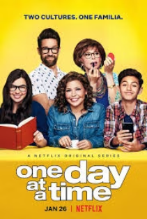
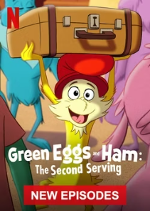

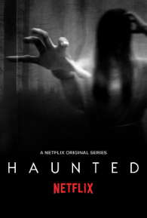
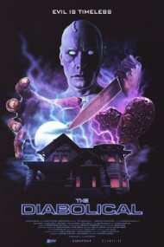



Comparision: Input - Final Destination 2 (Horror/Thriller/Teen)
Before:
After:

Slide 14





Business Impact
Cold Start Solutions
Personalization & Hybrid Approach
Content Discovery
The model is highly effective for cold-start situations — it can recommend new content based on metadata alone.
Due to absence of user feedback, it lacks personalization, making it better suited for hybrid systems with collaborative filtering.
Highlight lesser-known titles to improve content discovery and user satisfaction.
Catalog Utilization
User Experience (UX)
Promote underwatched titles, increasing catalog diversity
Increase trust with clear explanations (e.g., shared actors/themes). Organize recommendations by format (movie/TV show)

Slide 15




Model Limitation and Bias
User Preference Limitation
Dependence on Metadata
Lexical/Semantic Limitations
Bias in Data
Reflects regional stereotypes or underrepresentation, limiting cross-regional recommendations.
Lacks personalization, only recommending based on a single title without learning from user history or ratings.
Relies on potentially incomplete or overly detailed textual descriptions, impacting recommendation accuracy.
TF-IDF doesn't understand context, so “school” in a dark mystery teen drama and “school” in a light kids’ comedy are the same feature
Improvement Strategy: Incorporate collaborative filtering, semantic embeddings (e.g., BERT), and a feedback loop for continuous refinement.

Slide 16
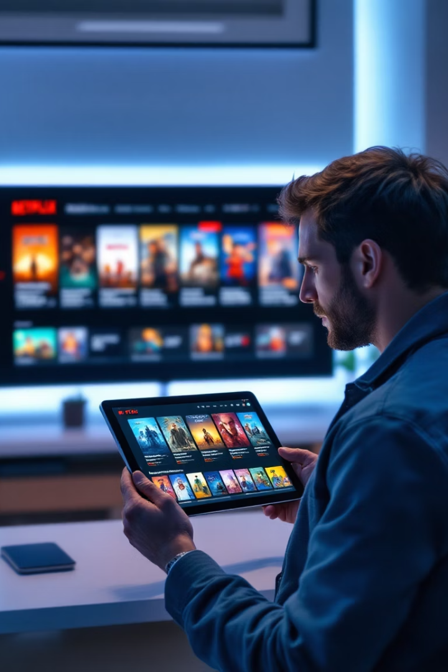
Future Scope and Conclusion
89%
10%
Novelty Score
Catalog Coverage
Unique recommendations across test cases
Of Netflix library recommended
0.093
Diversity Score
Low ILS indicates high recommendation diversity
Our content-based recommendation system successfully balances relevance with discovery, helping users find both similar content and unexpected gems.
Future improvements will focus on hybrid approaches combining content-based and collaborative filtering techniques to further personalize the user experience.

Slide 17
Thank you!

